Slide 1
St. Louis Central Corridor West Building Permits
Quarter 2 Report: 2020

Slide 2
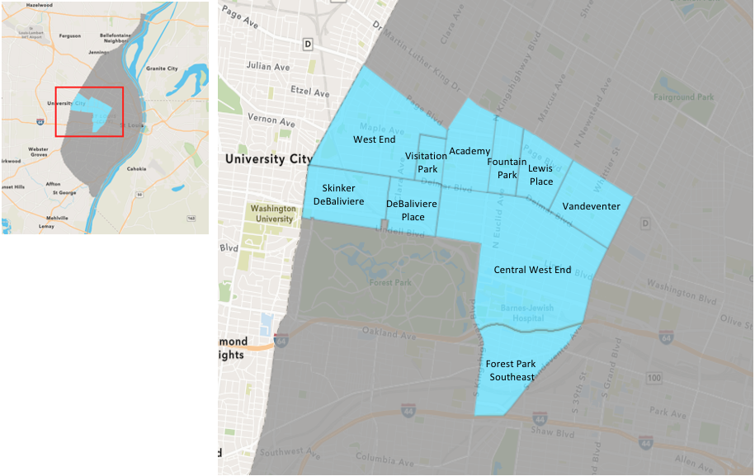
St. Louis Neighborhood Spatial Reference

Slide 3
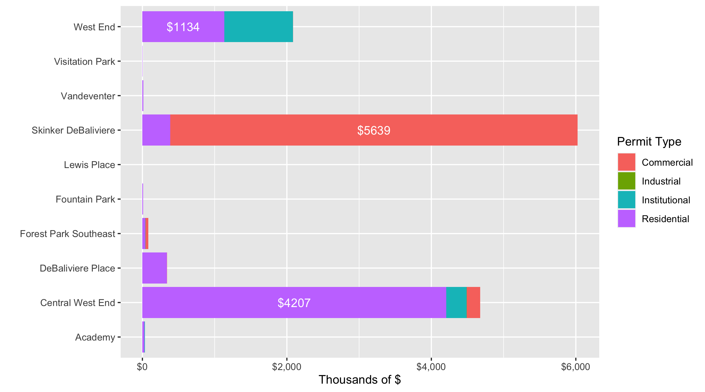
Neighborhood Summary: Total Building Permit Cost

Slide 4
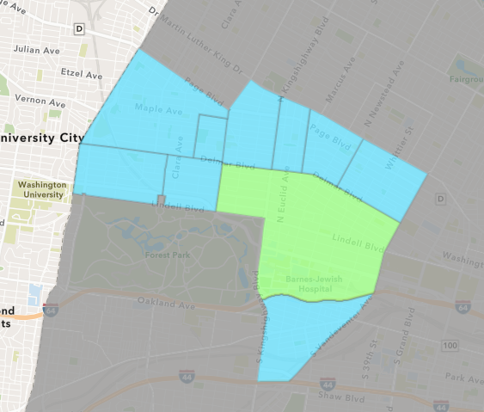
Central West End
Quarter 2 , 2020 Neighborhood Cost Breakdown
Sum of Permits: $46,681,384
Mean: $512,982
Median: $22,218
Range: $200 - $40,000,000

Slide 5
Central West End: Summary Notes
91 building permits in Quarter 2, 2020
-11.65% change compared to Quarter 2, 2019 (103 total building permits)
$512,982: Average building permit cost in Quarter 2, 2020
57.20% change compared to Quarter 2, 2019 ($326,323)

Slide 6
Central West End: Summary Notes
50 residential permits in Quarter 2, 2020
11.11% change compared to Quarter 2, 2019 (45 total building permits)
$841,329: Average residential building permit cost in Quarter 2, 2020
1345.04% change compared to Quarter 2, 2019 ($58,222)
1 industrial permits in Quarter 2, 2020
Infinite change compared to Quarter 2, 2019 (0 total building permits)
$20,000: Average industrial building permit cost in Quarter 2, 2020
Infinite change compared to Quarter 2, 2019 ($0)

Slide 7
Central West End: Summary Notes
16 commercial permits in Quarter 2, 2020
-23.81% change compared to Quarter 2, 2019 (21 total building permits)
$117,444: Average commercial building permit cost in Quarter 2, 2020
-66.09% change compared to Quarter 2, 2019 ($346,386)
27 residential permits in Quarter 2, 2020
-27.03% change compared to Quarter 2, 2019 (37 total building permits)
$103,933: Average institutional building permit cost in Quarter 2, 2020
-83.79% change compared to Quarter 2, 2019 ($0)

Slide 8
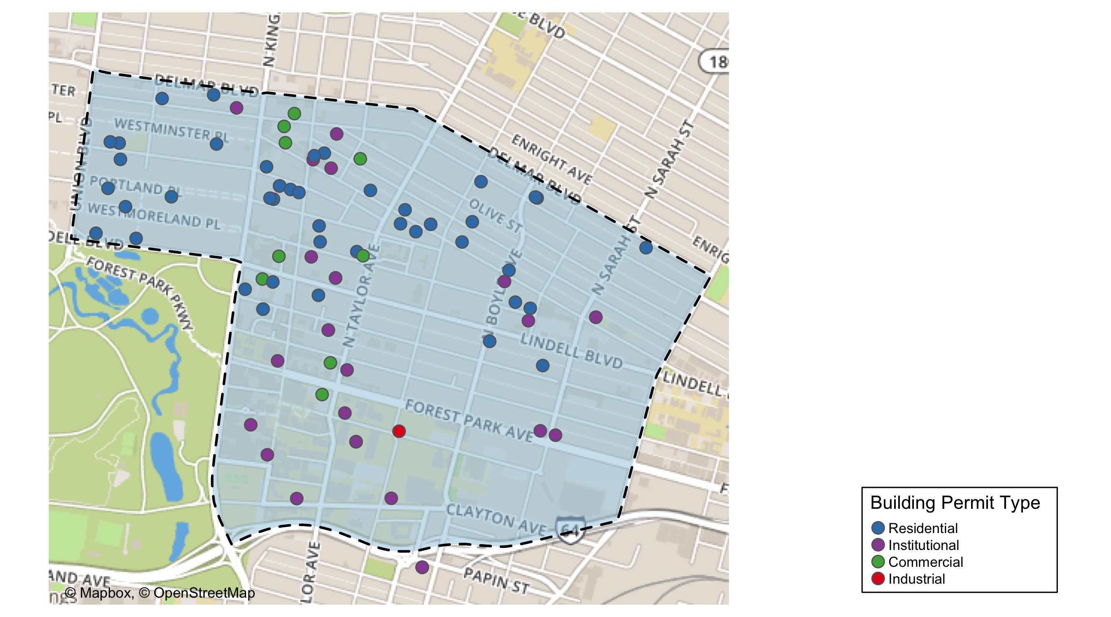
Central West End

Slide 9
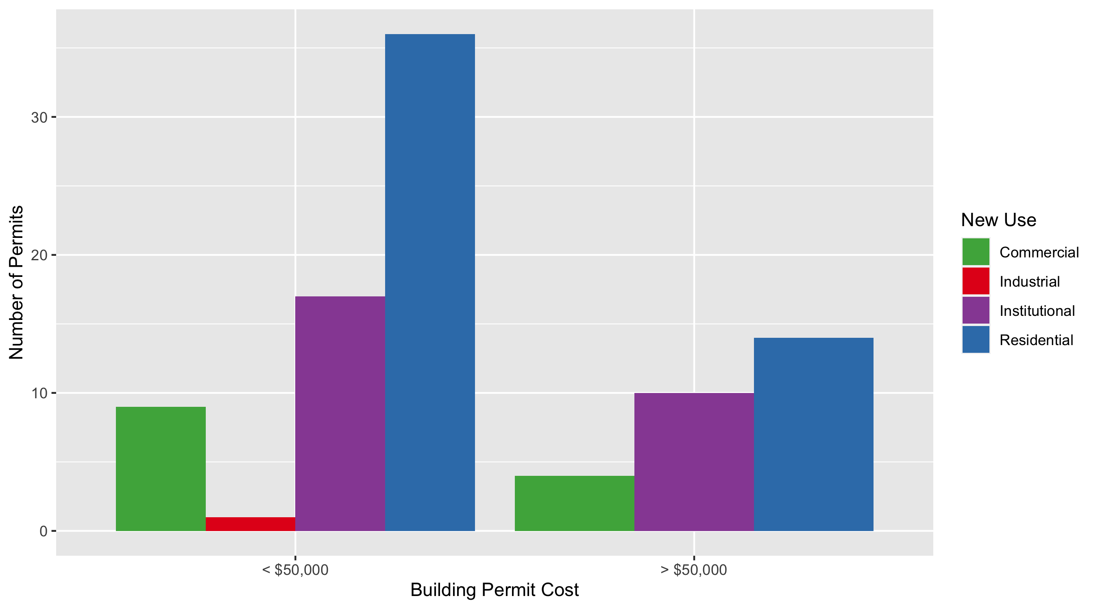
Central West End Permit Use Breakdown

Slide 10
Central West End Permit Breakdown
Quarter 2, 2020 | Quarter 2, 2020 | Quarter 2, 2020 | Quarter 2, 2020
Permit Use | Average Cost | # of Permits | Total Value of Permits
Commercial | $137,595 | 13 | $1,788,739
Industrial | $20,000 | 1 | $20,000
Institutional | $103,933 | 27 | $2,806,203
Residential | $841,329 | 50 | $42,066,442
Total | $1,102,858 | 91 | $46,681,384
Quarter 2, 2019 | Quarter 2, 2019 | Quarter 2, 2019 | Quarter 2, 2019
Permit Use | Average Cost | # of Permits | Total Value of Permits
Commercial | $346,386 | 21 | $7,274,104
Industrial | $0 | 0 | $0
Institutional | $641,004 | 37 | $23,717,142
Residential | $58,222 | 45 | $2,619,977
Total | $1,045,611 | 103 | $33,611,223

Slide 11
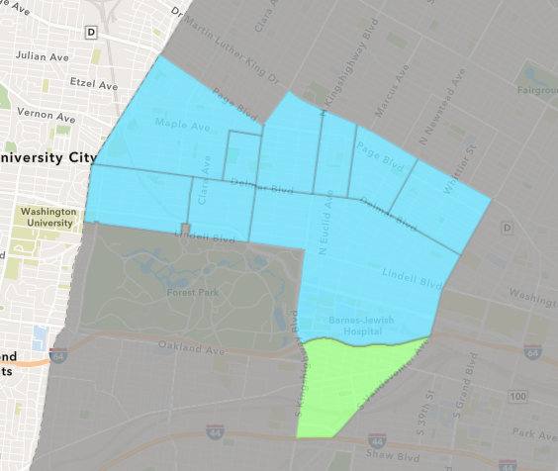
Forest Park Southeast
Quarter 2 , 2020 Neighborhood Cost Breakdown
Sum of Permits: $794,455
Mean: $29,424
Median: $7,700
Range: $50 - $169,955

Slide 12
Forest Park Southeast: Summary Notes
27 building permits in Quarter 2, 2020
-22.86% change compared to Quarter 2, 2019 (35 total building permits)
$29,424: Average building permit cost in Quarter 2, 2020
-41.40% change compared to Quarter 2, 2019 ($50,212)

Slide 13
Forest Park Southeast: Summary Notes
17 residential permits in Quarter 2, 2020
-5.56% change compared to Quarter 2, 2019 (18 total building permits)
$23,603: Average residential building permit cost in Quarter 2, 2020
-43.78% change compared to Quarter 2, 2019 ($41,987)
0 industrial permits in Quarter 2, 2020
0.00% change compared to Quarter 2, 2019 (0 total building permits)
$0: Average industrial building permit cost in Quarter 2, 2020
0.00% change compared to Quarter 2, 2019 ($0)

Slide 14
Forest Park Southeast: Summary Notes
7 commercial permits in Quarter 2, 2020
-22.22% change compared to Quarter 2, 2019 (9 total building permits)
$54,857: Average commercial building permit cost in Quarter 2, 2020
-37.38% change compared to Quarter 2, 2019 ($87,600)
4 residential permits in Quarter 2, 2020
-50.00% change compared to Quarter 2, 2019 (8 total building permits)
$6,050: Average institutional building permit cost in Quarter 2, 2020
-77.30% change compared to Quarter 2, 2019 ($0)

Slide 15
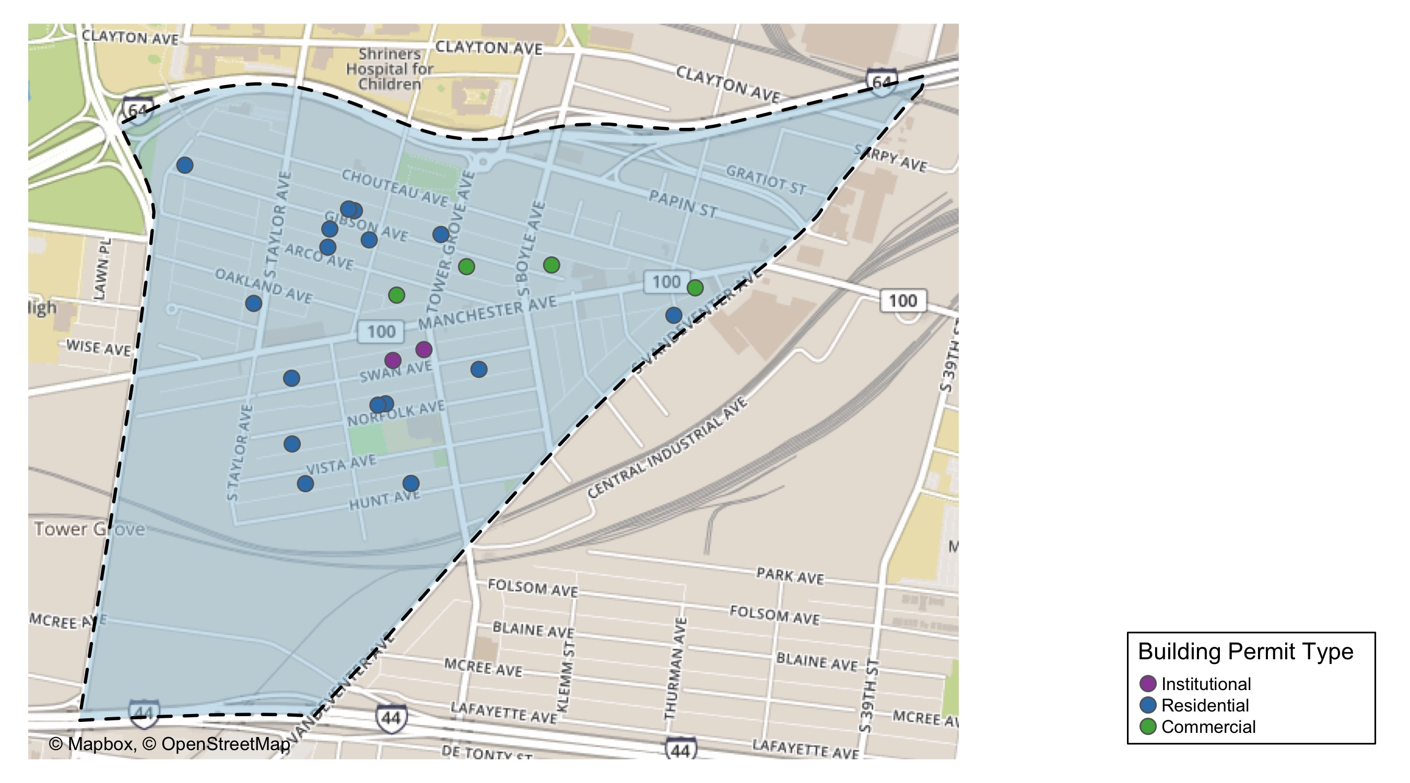
Forest Park Southeast

Slide 16
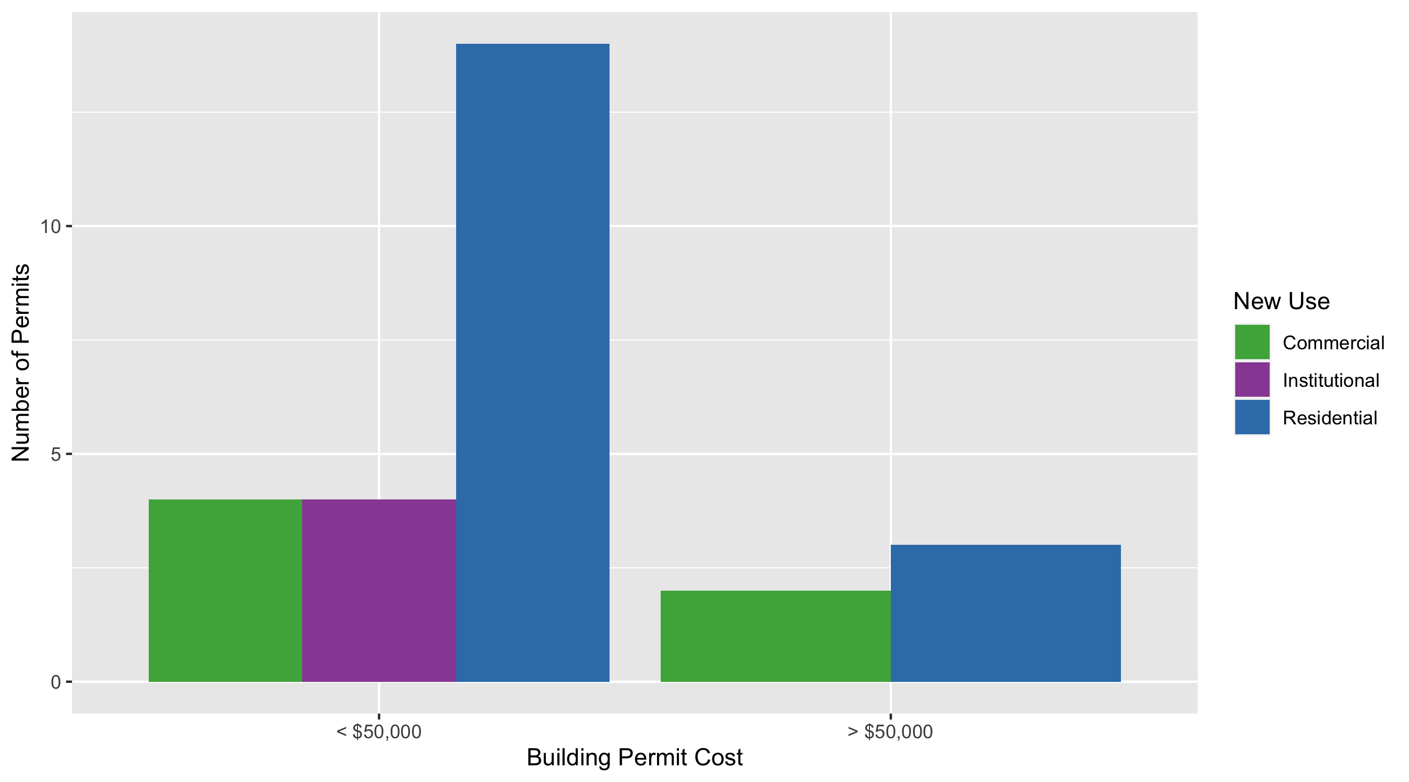
Forest Park Southeast Permit Use Breakdown

Slide 17
Forest Park Southeast Permit Breakdown
Quarter 2, 2020 | Quarter 2, 2020 | Quarter 2, 2020 | Quarter 2, 2020
Permit Use | Average Cost | # of Permits | Total Value of Permits
Commercial | $61,500 | 6 | $369,000
Industrial | $0 | 0 | $0
Institutional | $6,050 | 4 | $24,200
Residential | $23,603 | 17 | $401,255
Total | $91,153 | 27 | $794,455
Quarter 2, 2019 | Quarter 2, 2019 | Quarter 2, 2019 | Quarter 2, 2019
Permit Use | Average Cost | # of Permits | Total Value of Permits
Commercial | $87,600 | 9 | $788,400
Industrial | $0 | 0 | $0
Institutional | $26,656 | 8 | $213,250
Residential | $41,987 | 18 | $755,770
Total | $156,243 | 35 | $1,757,420

Slide 18
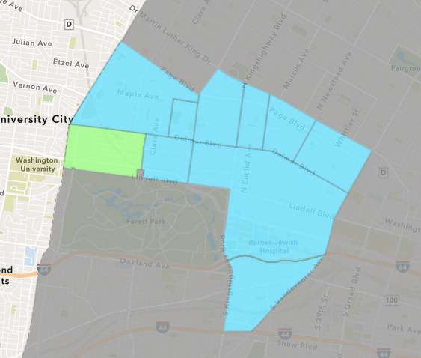
Skinker DeBaliviere
Quarter 2 , 2020 Neighborhood Cost Breakdown
Sum of Permits: $60,245,863
Mean: $2,077,444
Median: $20,700
Range: $1,000 - $33,603,927

Slide 19
Skinker DeBaliviere: Summary Notes
29 building permits in Quarter 2, 2020
107.14% change compared to Quarter 2, 2019 (14 total building permits)
$2,077,444: Average building permit cost in Quarter 2, 2020
17221.52% change compared to Quarter 2, 2019 ($11,993)

Slide 20
Skinker DeBaliviere: Summary Notes
26 residential permits in Quarter 2, 2020
136.36% change compared to Quarter 2, 2019 (11 total building permits)
$148,310: Average residential building permit cost in Quarter 2, 2020
1028.39% change compared to Quarter 2, 2019 ($13,144)
0 industrial permits in Quarter 2, 2020
0.00% change compared to Quarter 2, 2019 (0 total building permits)
$0: Average industrial building permit cost in Quarter 2, 2020
0.00% change compared to Quarter 2, 2019 ($0)

Slide 21
Skinker DeBaliviere: Summary Notes
3 commercial permits in Quarter 2, 2020
0.00% change compared to Quarter 2, 2019 (3 total building permits)
$18,796,603: Average commercial building permit cost in Quarter 2, 2020
241615.50% change compared to Quarter 2, 2019 ($7,776)
0 residential permits in Quarter 2, 2020
0.00% change compared to Quarter 2, 2019 (0 total building permits)
$0: Average institutional building permit cost in Quarter 2, 2020
0.00% change compared to Quarter 2, 2019 ($0)

Slide 22
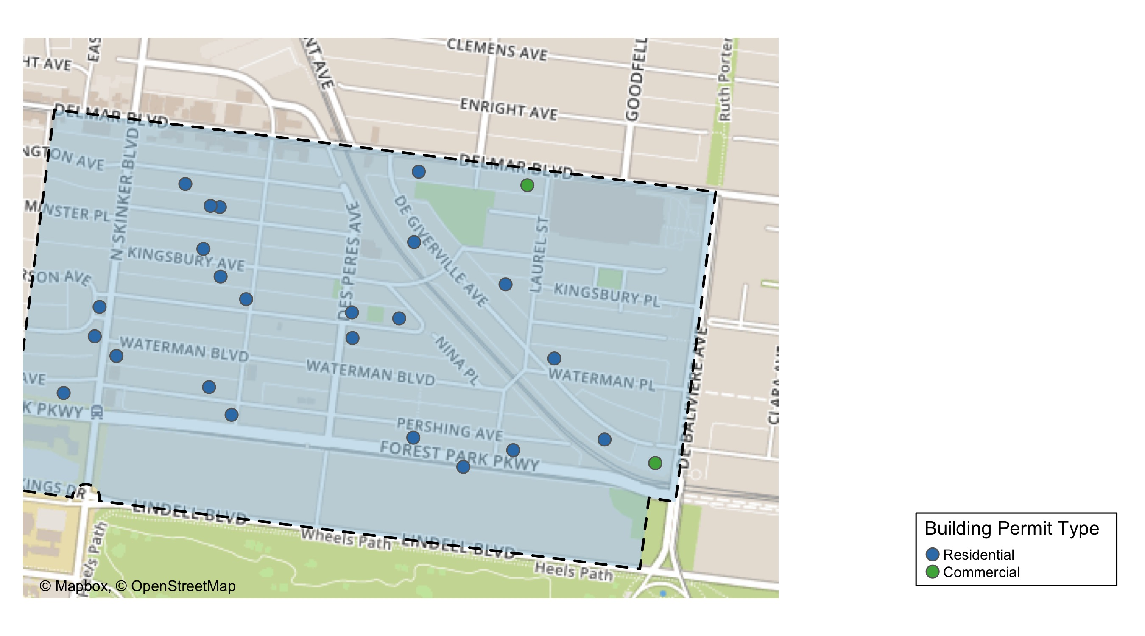
Skinker DeBaliviere

Slide 23
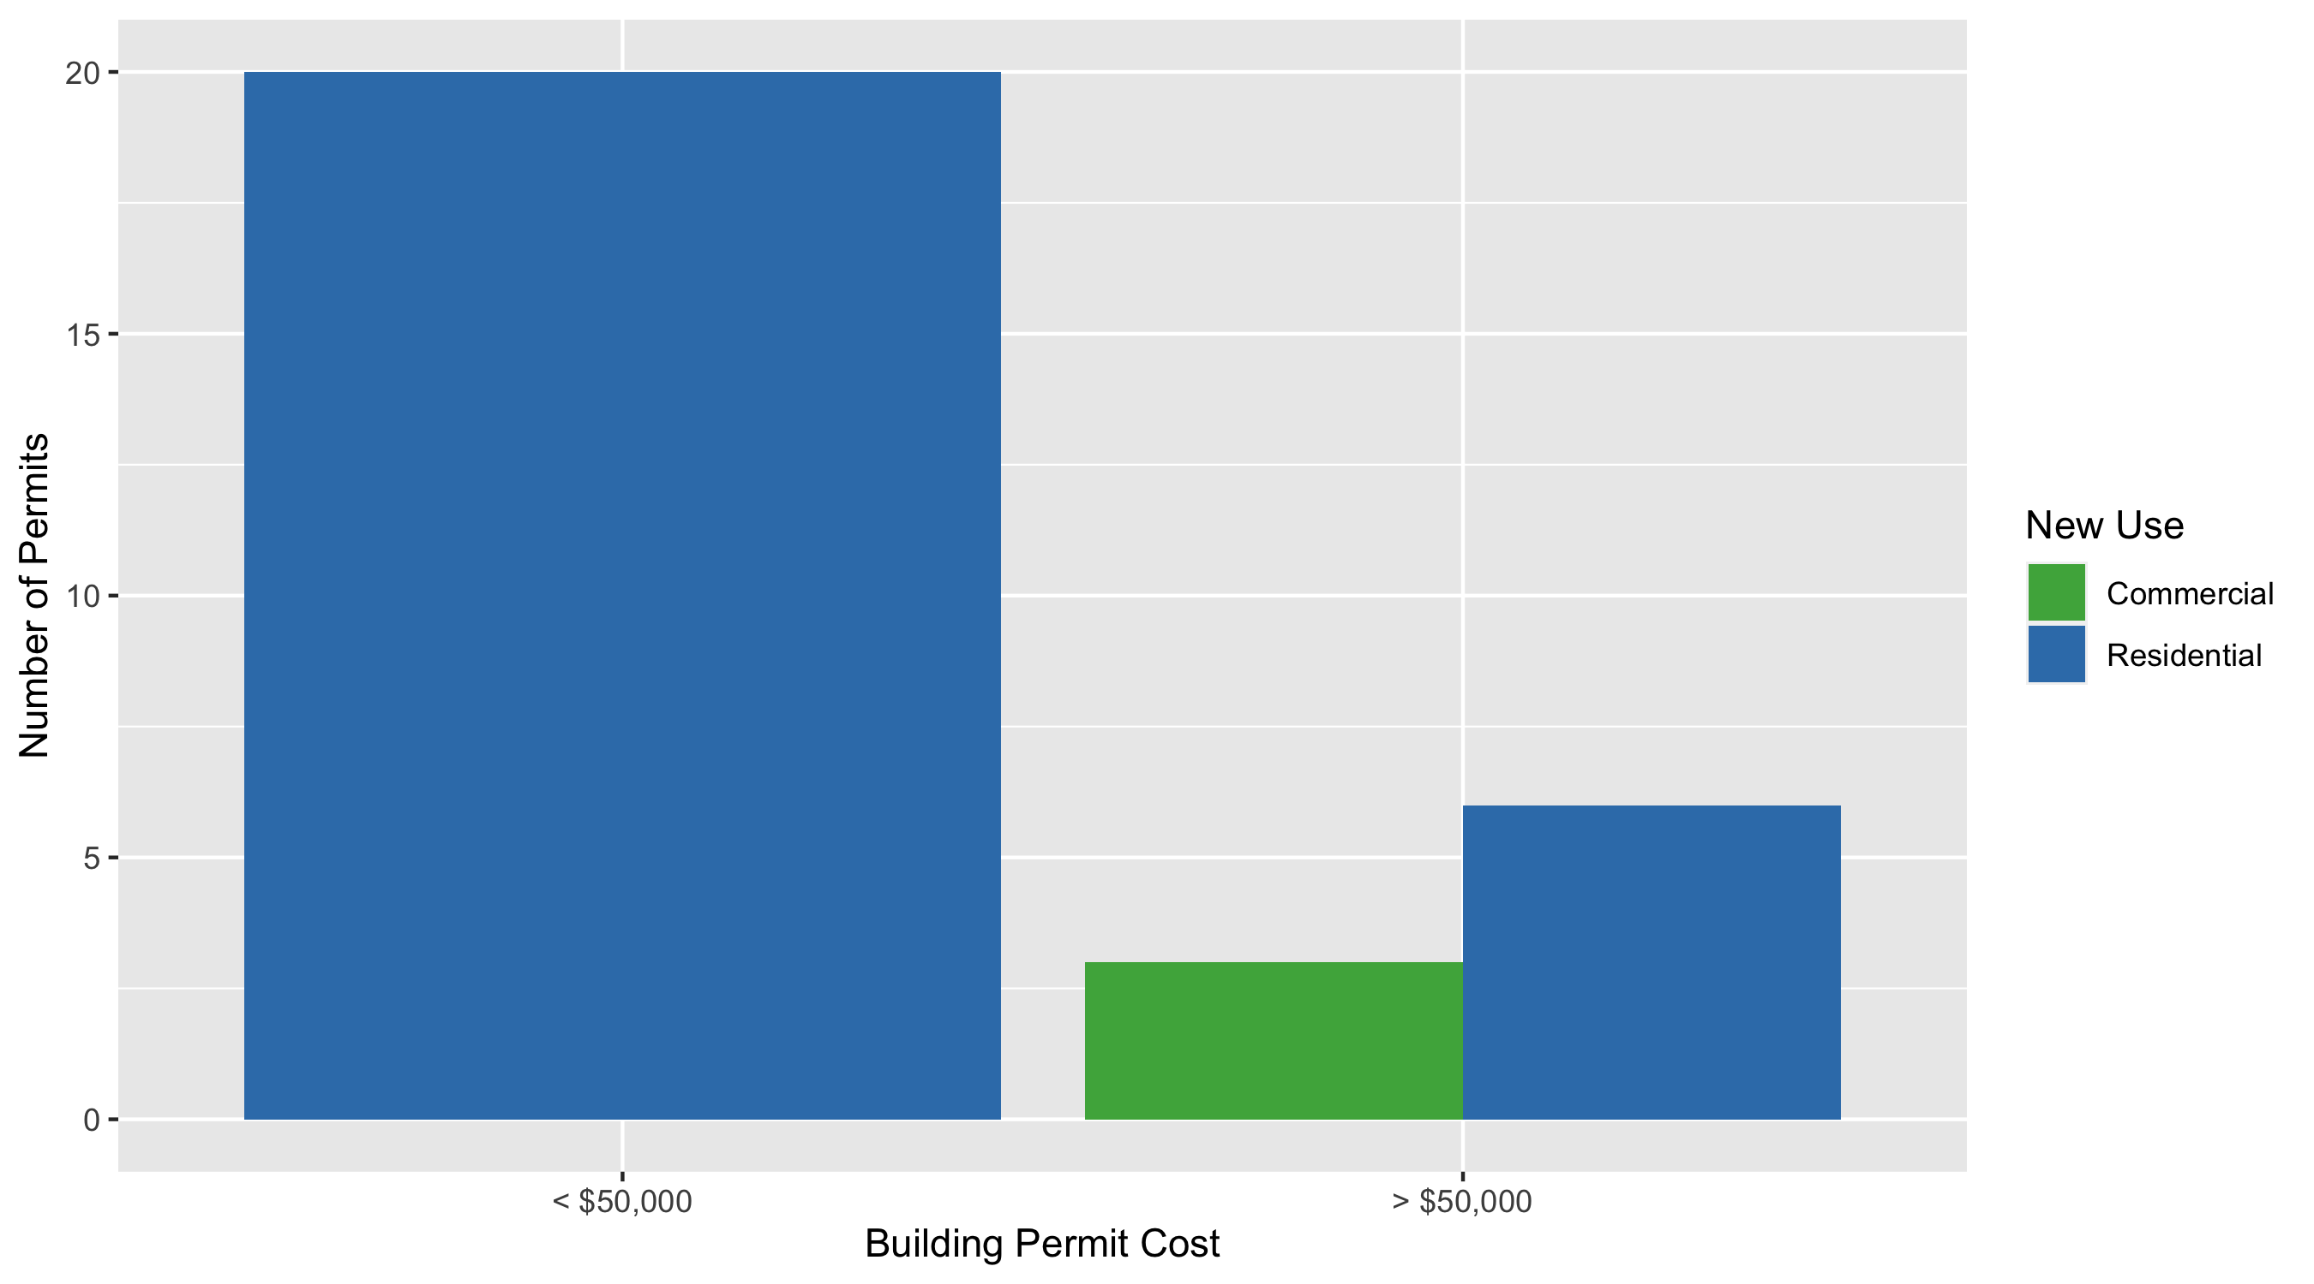
Skinker DeBaliviere Permit Use Breakdown

Slide 24
Skinker DeBaliviere Permit Breakdown
Quarter 2, 2020 | Quarter 2, 2020 | Quarter 2, 2020 | Quarter 2, 2020
Permit Use | Average Cost | # of Permits | Total Value of Permits
Commercial | $18,796,603 | 3 | $56,389,808
Industrial | $0 | 0 | $0
Institutional | $0 | 0 | $0
Residential | $148,310 | 26 | $3,856,055
Total | $18,944,912 | 29 | $60,245,863
Quarter 2, 2019 | Quarter 2, 2019 | Quarter 2, 2019 | Quarter 2, 2019
Permit Use | Average Cost | # of Permits | Total Value of Permits
Commercial | $7,776 | 3 | $23,329
Industrial | $0 | 0 | $0
Institutional | $0 | 0 | $0
Residential | $13,144 | 11 | $144,579
Total | $20,920 | 14 | $167,908

Slide 25
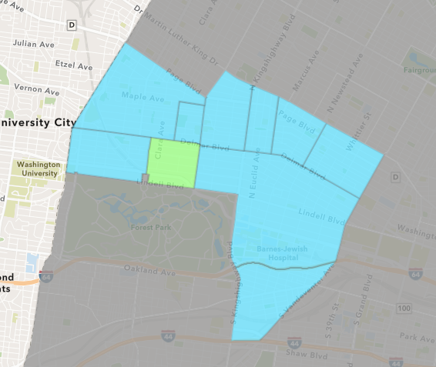
DeBaliviere Place
Quarter 2 , 2020 Neighborhood Cost Breakdown
Sum of Permits: $3,399,060
Mean: $242,790
Median: $29,456
Range: $600 - $2,435,000

Slide 26
DeBaliviere Place: Summary Notes
14 building permits in Quarter 2, 2020
0.00% change compared to Quarter 2, 2019 (14 total building permits)
$242,790: Average building permit cost in Quarter 2, 2020
262.33% change compared to Quarter 2, 2019 ($67,009)

Slide 27
DeBaliviere Place: Summary Notes
13 residential permits in Quarter 2, 2020
0.00% change compared to Quarter 2, 2019 (13 total building permits)
$259,543: Average residential building permit cost in Quarter 2, 2020
265.50% change compared to Quarter 2, 2019 ($71,010)
0 industrial permits in Quarter 2, 2020
0.00% change compared to Quarter 2, 2019 (0 total building permits)
$0: Average industrial building permit cost in Quarter 2, 2020
0.00% change compared to Quarter 2, 2019 ($0)

Slide 28
DeBaliviere Place: Summary Notes
1 commercial permits in Quarter 2, 2020
0.00% change compared to Quarter 2, 2019 (1 total building permits)
$25,000: Average commercial building permit cost in Quarter 2, 2020
66.67% change compared to Quarter 2, 2019 ($15,000)
0 residential permits in Quarter 2, 2020
0.00% change compared to Quarter 2, 2019 (0 total building permits)
$0: Average institutional building permit cost in Quarter 2, 2020
0.00% change compared to Quarter 2, 2019 ($0)

Slide 29
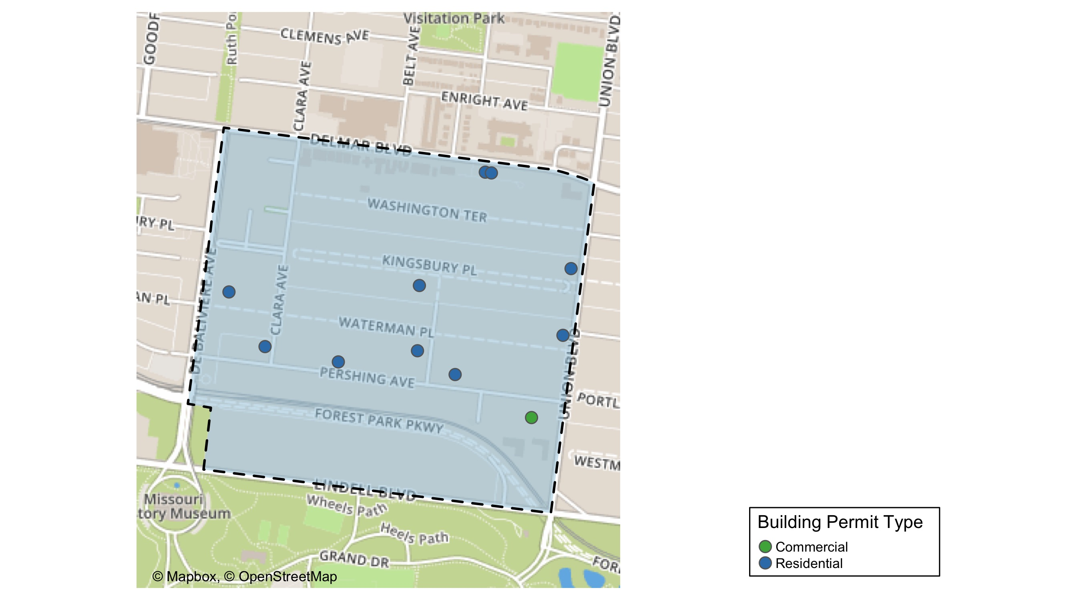
DeBaliviere Place

Slide 30
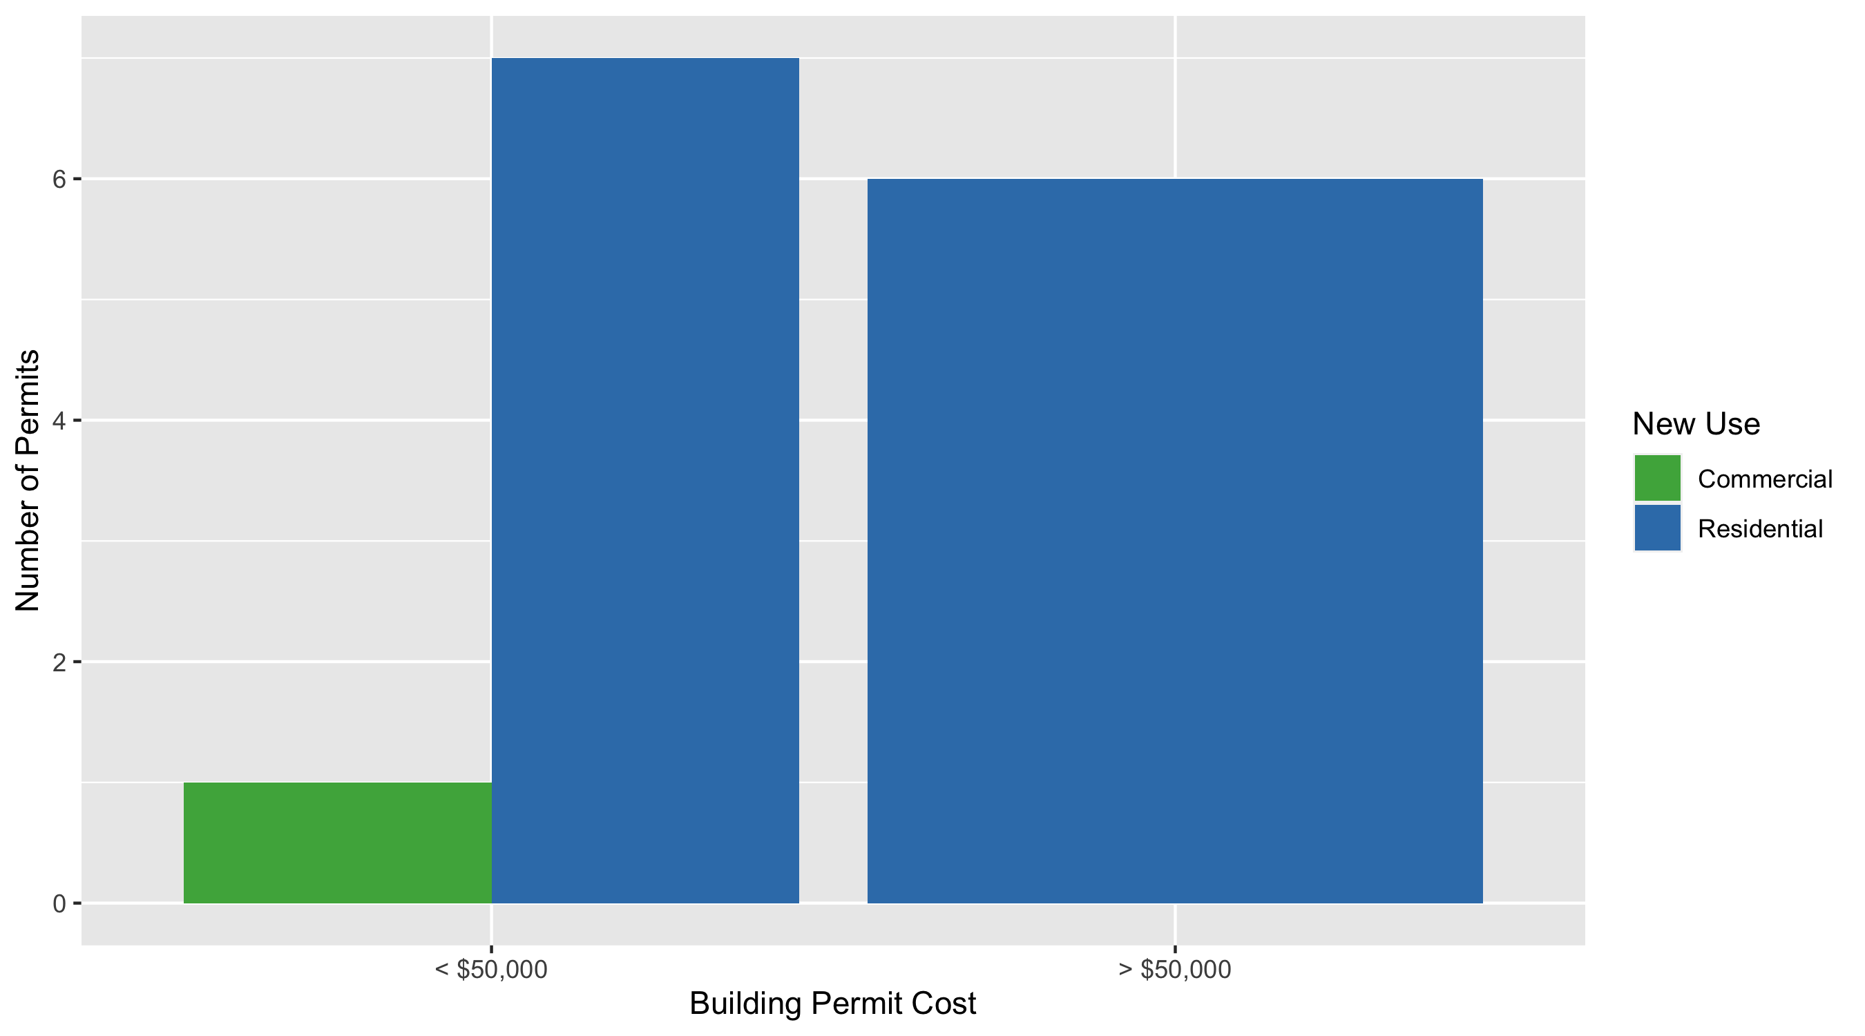
DeBaliviere Place Permit Use Breakdown

Slide 31
DeBaliviere Place Permit Breakdown
Quarter 2, 2020 | Quarter 2, 2020 | Quarter 2, 2020 | Quarter 2, 2020
Permit Use | Average Cost | # of Permits | Total Value of Permits
Commercial | $25,000 | 1 | $25,000
Industrial | $0 | 0 | $0
Institutional | $0 | 0 | $0
Residential | $259,543 | 13 | $3,374,060
Total | $284,543 | 14 | $3,399,060
Quarter 2, 2019 | Quarter 2, 2019 | Quarter 2, 2019 | Quarter 2, 2019
Permit Use | Average Cost | # of Permits | Total Value of Permits
Commercial | $15,000 | 1 | $15,000
Industrial | $0 | 0 | $0
Institutional | $0 | 0 | $0
Residential | $71,010 | 13 | $923,124
Total | $86,010 | 14 | $938,124

Slide 32
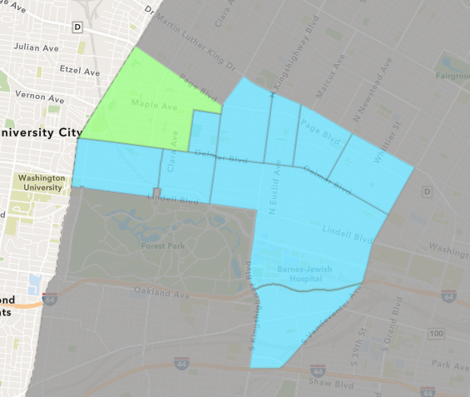
West End
Quarter 2 , 2020 Neighborhood Cost Breakdown
Sum of Permits: $519,850
Mean: $64,981
Median: $14,500
Range: $3,600 - $325,000

Slide 33
West End: Summary Notes
8 building permits in Quarter 2, 2020
0.00% change compared to Quarter 2, 2019 (8 total building permits)
$64,981: Average building permit cost in Quarter 2, 2020
352.04% change compared to Quarter 2, 2019 ($14,375)

Slide 34
West End: Summary Notes
8 residential permits in Quarter 2, 2020
33.33% change compared to Quarter 2, 2019 (6 total building permits)
$1,418,106: Average residential building permit cost in Quarter 2, 2020
16917.28% change compared to Quarter 2, 2019 ($8,333)
0 industrial permits in Quarter 2, 2020
0.00% change compared to Quarter 2, 2019 (0 total building permits)
$0: Average industrial building permit cost in Quarter 2, 2020
0.00% change compared to Quarter 2, 2019 ($0)

Slide 35
West End: Summary Notes
1 commercial permits in Quarter 2, 2020
0.00% change compared to Quarter 2, 2019 (1 total building permits)
$15,000: Average commercial building permit cost in Quarter 2, 2020
-40.00% change compared to Quarter 2, 2019 ($25,000)
1 residential permits in Quarter 2, 2020
0.00% change compared to Quarter 2, 2019 (1 total building permits)
$9,486,000: Average institutional building permit cost in Quarter 2, 2020
23615.00% change compared to Quarter 2, 2019 ($0)

Slide 36
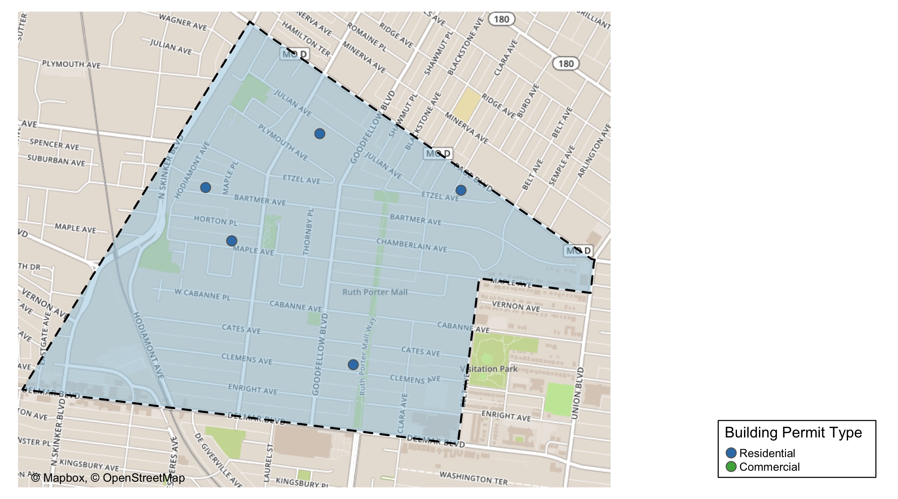
West End

Slide 37
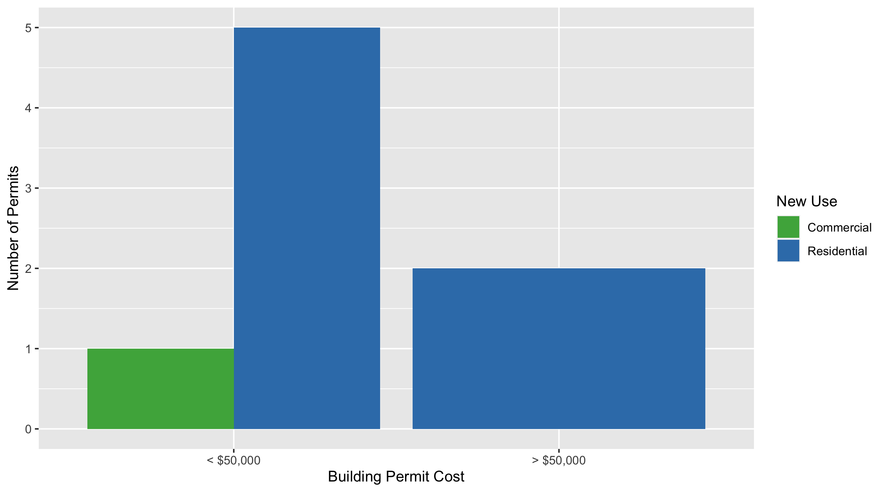
West End Permit Use Breakdown

Slide 38
West End Permit Breakdown
Quarter 2, 2020 | Quarter 2, 2020 | Quarter 2, 2020 | Quarter 2, 2020
Permit Use | Average Cost | # of Permits | Total Value of Permits
Commercial | $15,000 | 1 | $15,000
Industrial | $0 | 0 | $0
Institutional | $0 | 0 | $0
Residential | $72,121 | 7 | $504,850
Total | $87,121 | 8 | $519,850
Quarter 2, 2019 | Quarter 2, 2019 | Quarter 2, 2019 | Quarter 2, 2019
Permit Use | Average Cost | # of Permits | Total Value of Permits
Commercial | $25,000 | 1 | $25,000
Industrial | $0 | 0 | $0
Institutional | $40,000 | 1 | $40,000
Residential | $8,333 | 6 | $50,000
Total | $73,333 | 8 | $115,000

Slide 39
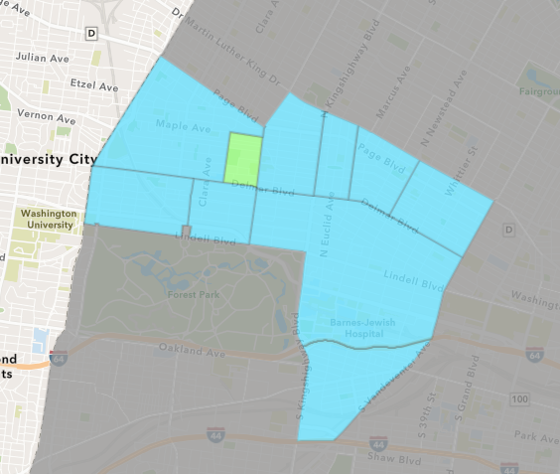
Visitation Park
Quarter 2 , 2020 Neighborhood Cost Breakdown
Sum of Permits: $7,250
Mean: $7,250
Median: $7,250
Range: $7,250 - $7,250

Slide 40
Visitation Park: Summary Notes
1 building permits in Quarter 2, 2020
Infinite change compared to Quarter 2, 2019 (0 total building permits)
$7,250: Average building permit cost in Quarter 2, 2020
Infinite change compared to Quarter 2, 2019 ($0)

Slide 41
Visitation Park: Summary Notes
1 residential permits in Quarter 2, 2020
Infinite change compared to Quarter 2, 2019 (0 total building permits)
$7,250: Average residential building permit cost in Quarter 2, 2020
Infinite change compared to Quarter 2, 2019 ($0)
0 industrial permits in Quarter 2, 2020
0.00% change compared to Quarter 2, 2019 (0 total building permits)
$0: Average industrial building permit cost in Quarter 2, 2020
0.00% change compared to Quarter 2, 2019 ($0)

Slide 42
Visitation Park: Summary Notes
0 commercial permits in Quarter 2, 2020
0.00% change compared to Quarter 2, 2019 (0 total building permits)
$0: Average commercial building permit cost in Quarter 2, 2020
0.00% change compared to Quarter 2, 2019 ($0)
0 residential permits in Quarter 2, 2020
0.00% change compared to Quarter 2, 2019 (0 total building permits)
$0: Average institutional building permit cost in Quarter 2, 2020
0.00% change compared to Quarter 2, 2019 ($0)

Slide 43
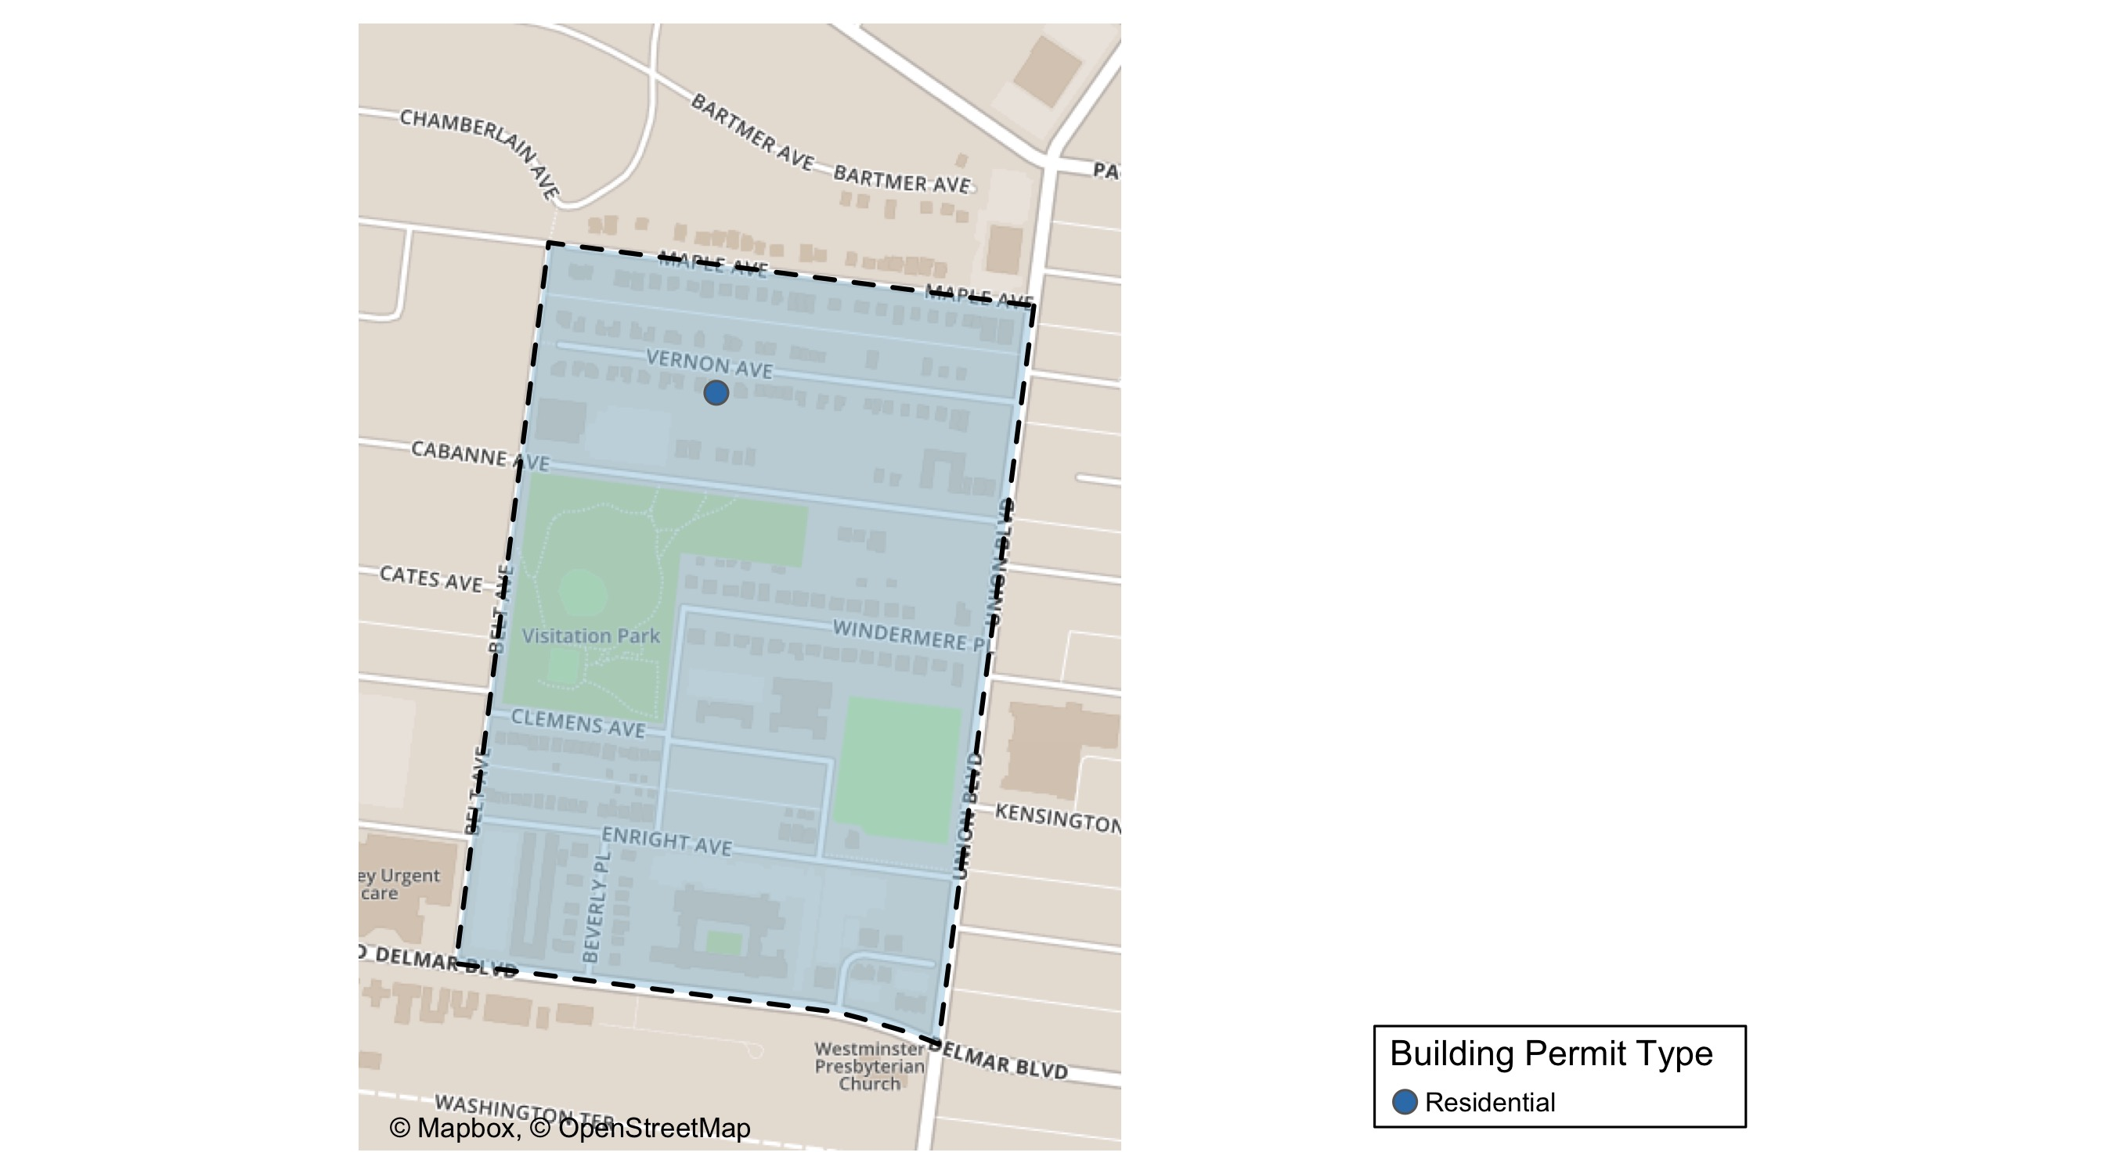
Visitation Park

Slide 44
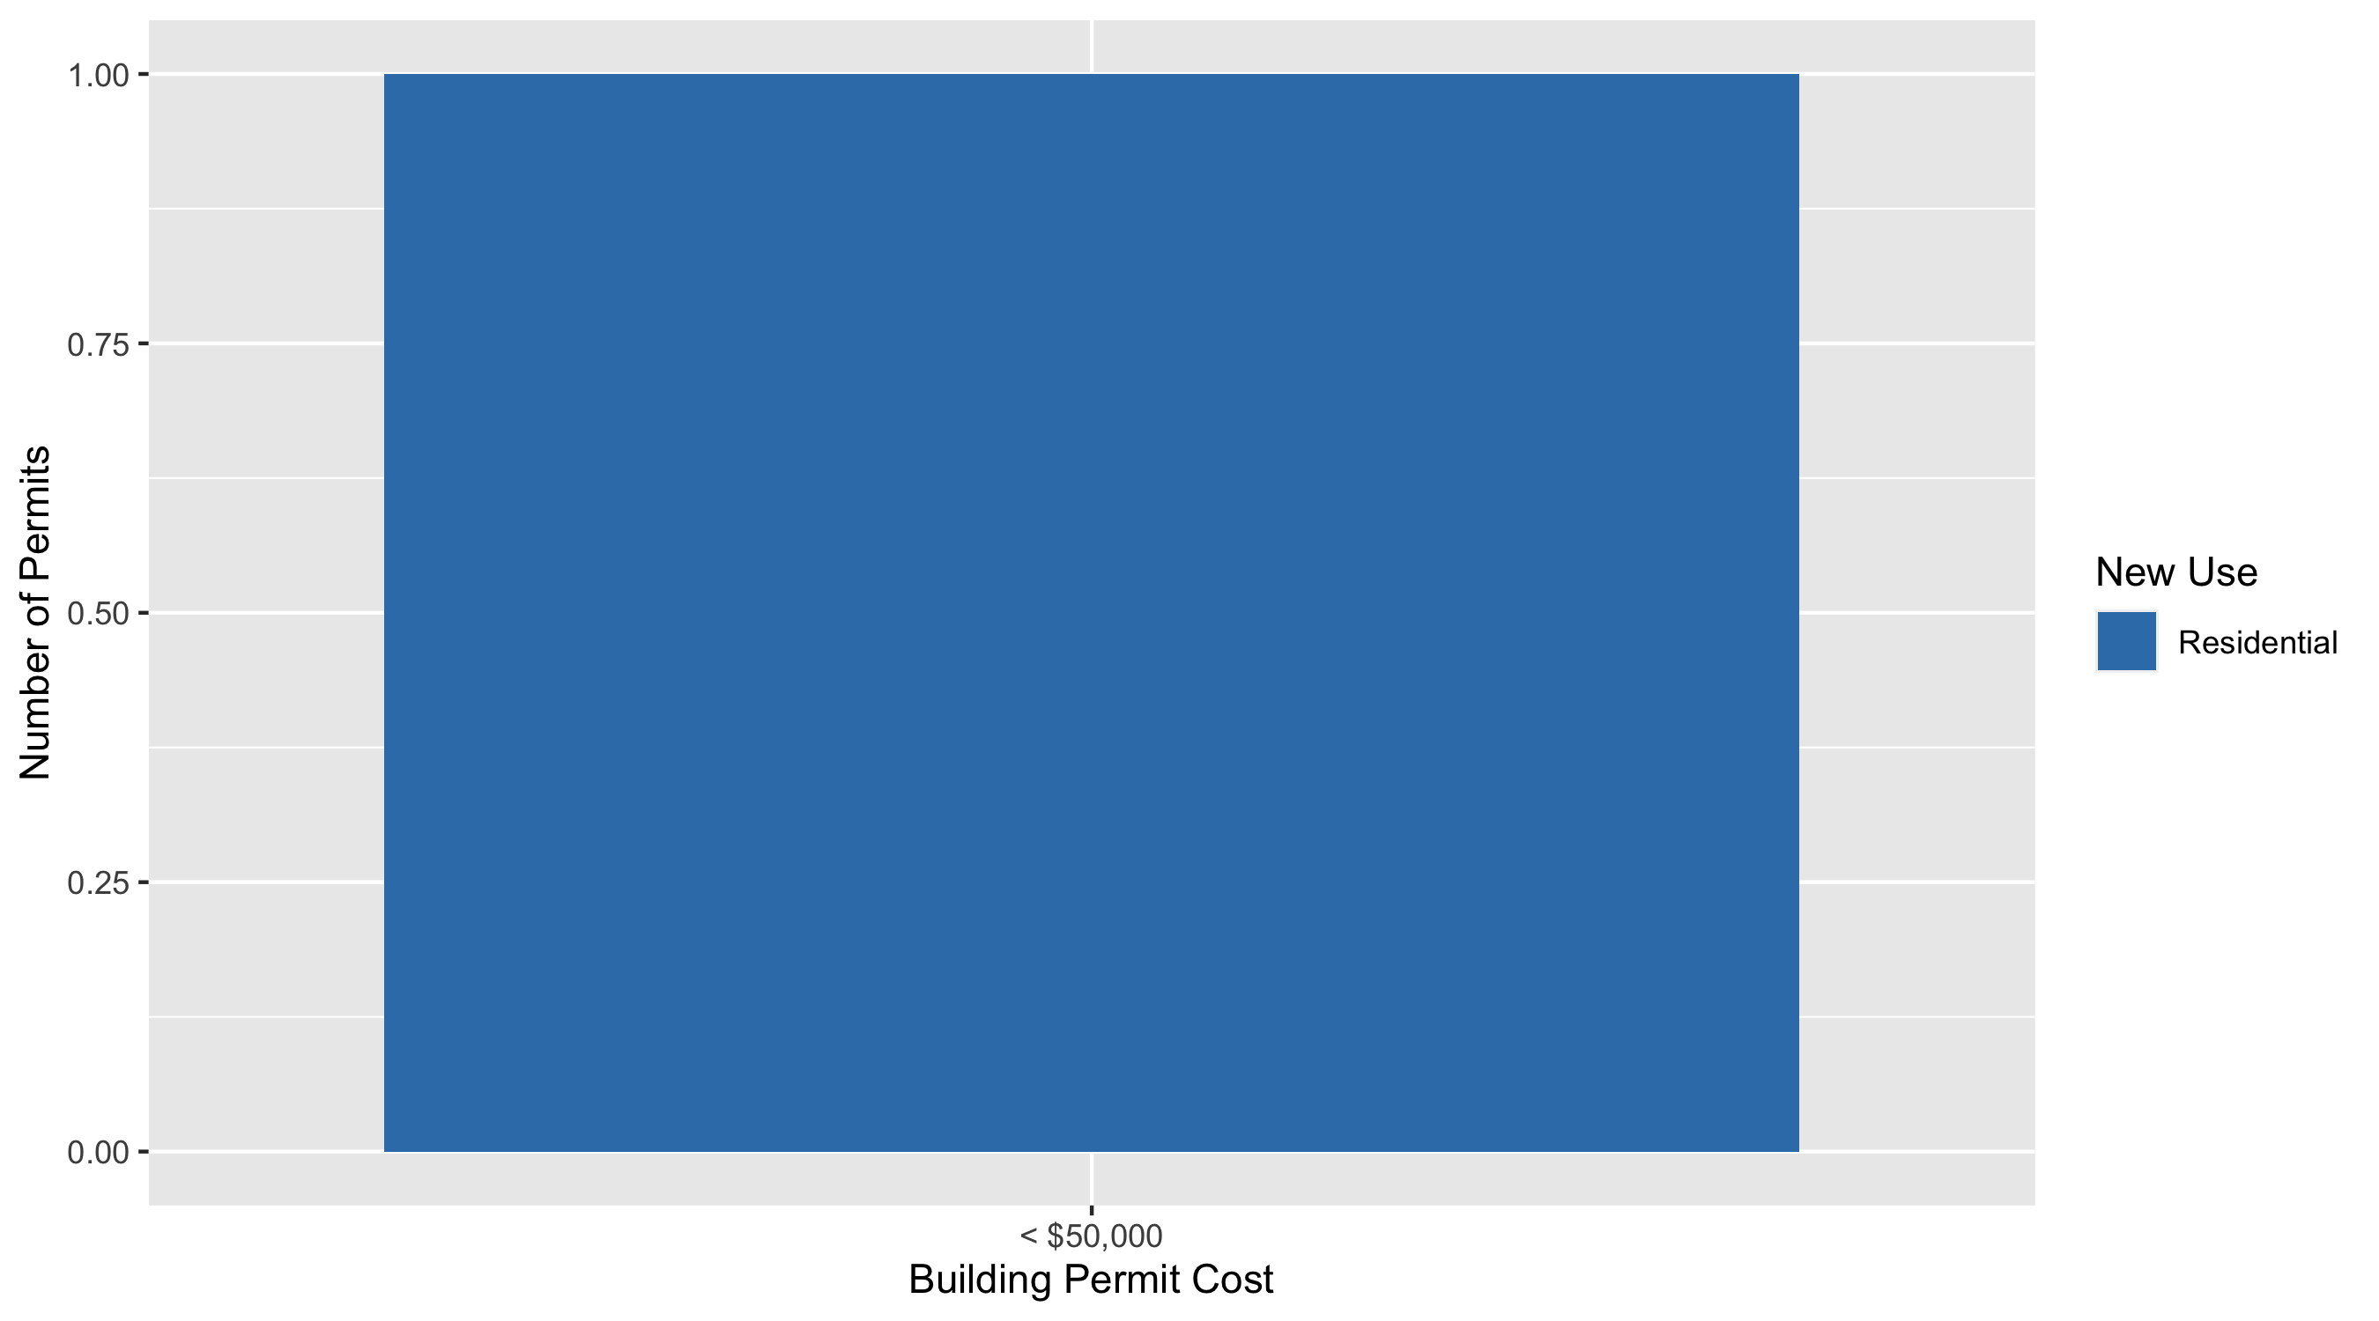
Visitation Park Permit Use Breakdown

Slide 45
Visitation Park Permit Breakdown
Quarter 2, 2020 | Quarter 2, 2020 | Quarter 2, 2020 | Quarter 2, 2020
Permit Use | Average Cost | # of Permits | Total Value of Permits
Commercial | $0 | 0 | $0
Industrial | $0 | 0 | $0
Institutional | $0 | 0 | $0
Residential | $7,250 | 1 | $7,250
Total | $7,250 | 1 | $7,250
Quarter 2, 2019 | Quarter 2, 2019 | Quarter 2, 2019 | Quarter 2, 2019
Permit Use | Average Cost | # of Permits | Total Value of Permits
Commercial | $0 | 0 | $0
Industrial | $0 | 0 | $0
Institutional | $0 | 0 | $0
Residential | $0 | 0 | $0
Total | $0 | 0 | $0

Slide 46
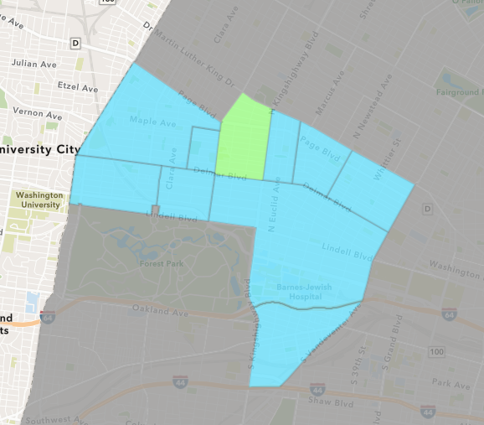
Academy
Quarter 2 , 2020 Neighborhood Cost Breakdown
Sum of Permits: $334,150
Mean: $30,377
Median: $3,500
Range: $700 - $150,000

Slide 47
Academy: Summary Notes
11 building permits in Quarter 2, 2020
0.00% change compared to Quarter 2, 2019 (11 total building permits)
$30,377: Average building permit cost in Quarter 2, 2020
-46.58% change compared to Quarter 2, 2019 ($56,864)

Slide 48
Academy: Summary Notes
10 residential permits in Quarter 2, 2020
0.00% change compared to Quarter 2, 2019 (10 total building permits)
$28,415: Average residential building permit cost in Quarter 2, 2020
-54.06% change compared to Quarter 2, 2019 ($61,850)
0 industrial permits in Quarter 2, 2020
0.00% change compared to Quarter 2, 2019 (0 total building permits)
$0: Average industrial building permit cost in Quarter 2, 2020
0.00% change compared to Quarter 2, 2019 ($0)

Slide 49
Academy: Summary Notes
0 commercial permits in Quarter 2, 2020
0.00% change compared to Quarter 2, 2019 (0 total building permits)
$0: Average commercial building permit cost in Quarter 2, 2020
0.00% change compared to Quarter 2, 2019 ($0)
1 residential permits in Quarter 2, 2020
0.00% change compared to Quarter 2, 2019 (1 total building permits)
$50,000: Average institutional building permit cost in Quarter 2, 2020
614.29% change compared to Quarter 2, 2019 ($0)

Slide 50
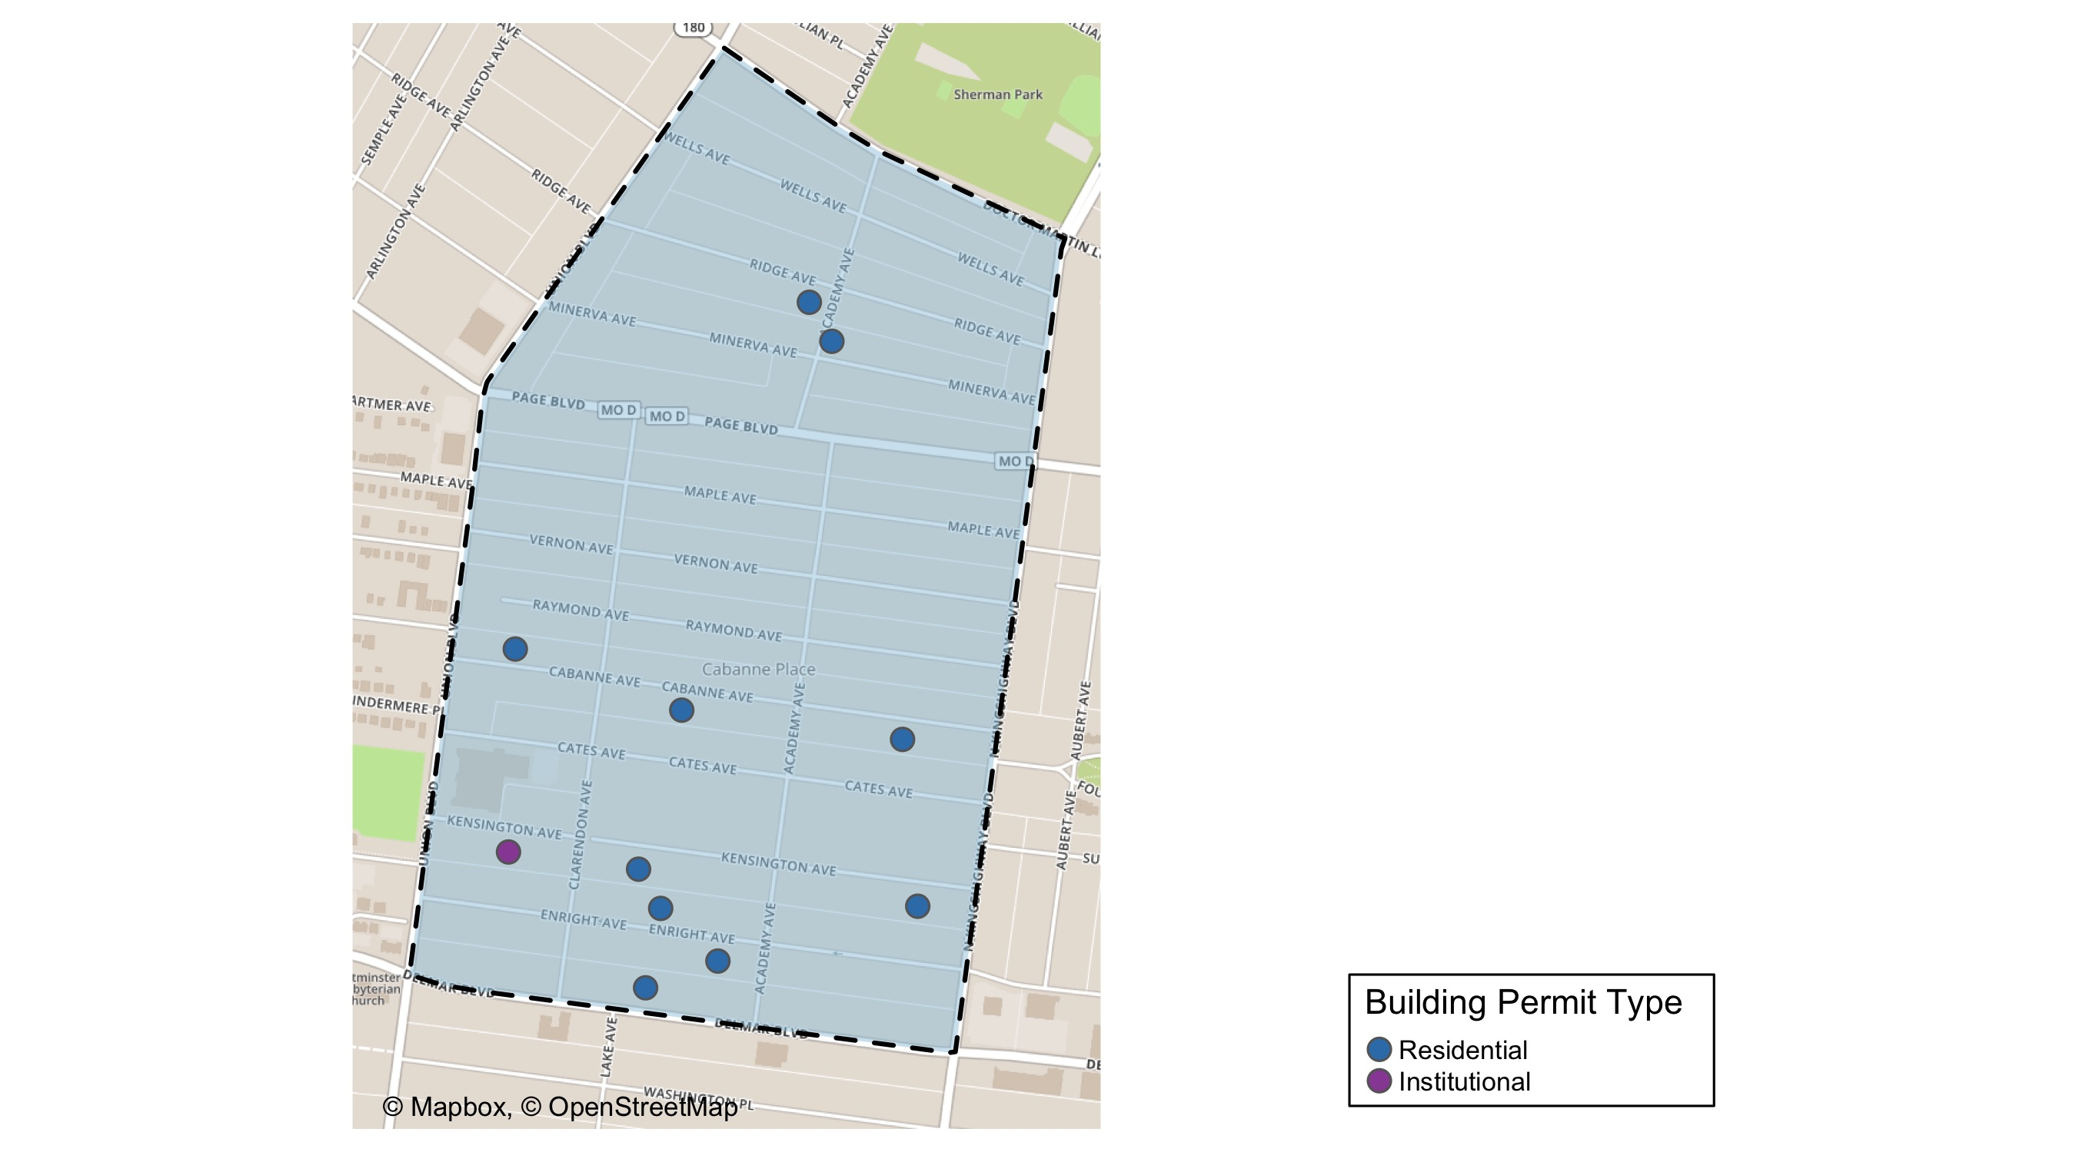
Academy

Slide 51
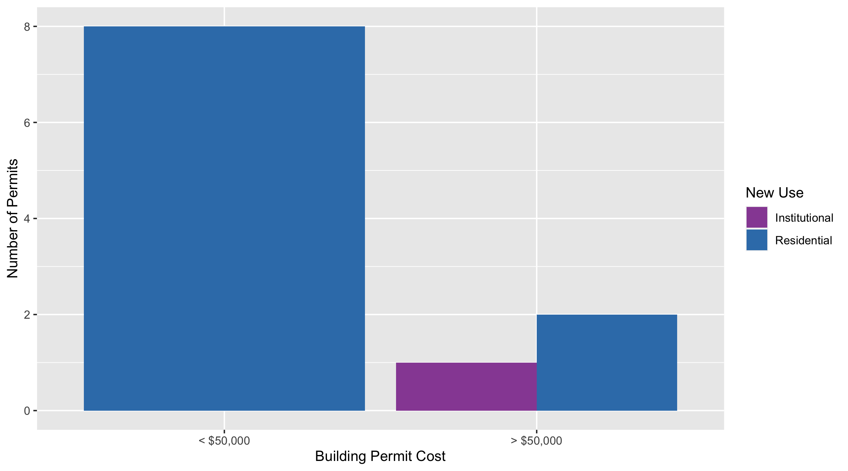
Academy Permit Use Breakdown

Slide 52
Academy Permit Breakdown
Quarter 2, 2020 | Quarter 2, 2020 | Quarter 2, 2020 | Quarter 2, 2020
Permit Use | Average Cost | # of Permits | Total Value of Permits
Commercial | $0 | 0 | $0
Industrial | $0 | 0 | $0
Institutional | $50,000 | 1 | $50,000
Residential | $28,415 | 10 | $284,150
Total | $78,415 | 11 | $334,150
Quarter 2, 2019 | Quarter 2, 2019 | Quarter 2, 2019 | Quarter 2, 2019
Permit Use | Average Cost | # of Permits | Total Value of Permits
Commercial | $0 | 0 | $0
Industrial | $0 | 0 | $0
Institutional | $7,000 | 1 | $7,000
Residential | $61,850 | 10 | $618,500
Total | $68,850 | 11 | $625,500

Slide 53
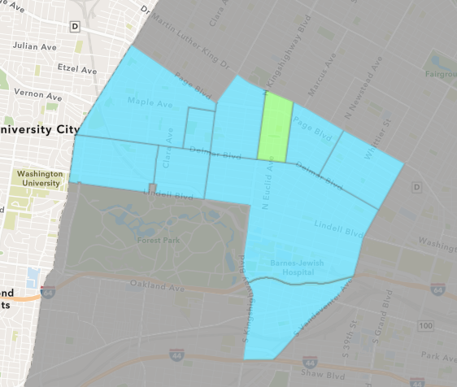
Fountain Park
Quarter 2 , 2020 Neighborhood Cost Breakdown
Sum of Permits: $106,500
Mean: $26,625
Median: $10,250
Range: $1,000 - $85,000

Slide 54
Fountain Park: Summary Notes
4 building permits in Quarter 2, 2020
33.33% change compared to Quarter 2, 2019 (3 total building permits)
$26,625: Average building permit cost in Quarter 2, 2020
-39.94% change compared to Quarter 2, 2019 ($44,333)

Slide 55
Fountain Park: Summary Notes
4 residential permits in Quarter 2, 2020
33.33% change compared to Quarter 2, 2019 (3 total building permits)
$26,625: Average residential building permit cost in Quarter 2, 2020
-39.94% change compared to Quarter 2, 2019 ($44,333)
0 industrial permits in Quarter 2, 2020
0.00% change compared to Quarter 2, 2019 (0 total building permits)
$0: Average industrial building permit cost in Quarter 2, 2020
0.00% change compared to Quarter 2, 2019 ($0)

Slide 56
Fountain Park: Summary Notes
0 commercial permits in Quarter 2, 2020
0.00% change compared to Quarter 2, 2019 (0 total building permits)
$0: Average commercial building permit cost in Quarter 2, 2020
0.00% change compared to Quarter 2, 2019 ($0)
0 residential permits in Quarter 2, 2020
0.00% change compared to Quarter 2, 2019 (0 total building permits)
$0: Average institutional building permit cost in Quarter 2, 2020
0.00% change compared to Quarter 2, 2019 ($0)

Slide 57
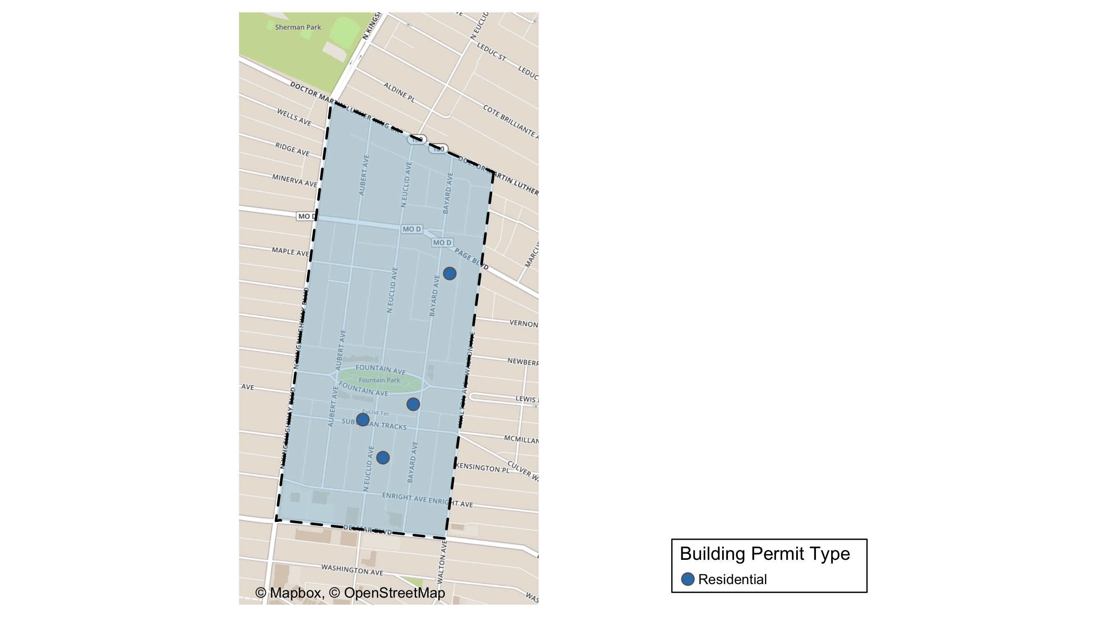
Fountain Park

Slide 58
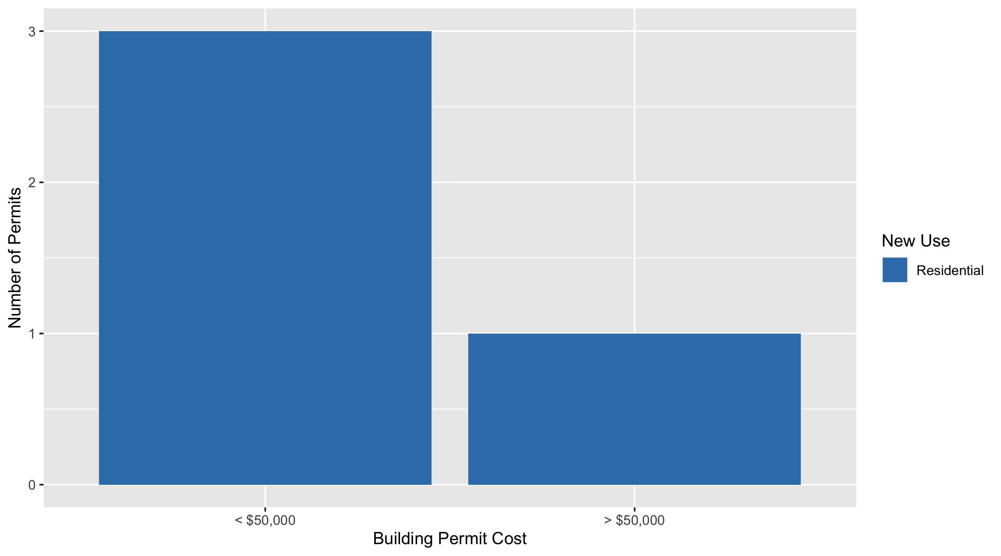
Fountain Park Permit Use Breakdown

Slide 59
Fountain Park Permit Breakdown
Quarter 2, 2020 | Quarter 2, 2020 | Quarter 2, 2020 | Quarter 2, 2020
Permit Use | Average Cost | # of Permits | Total Value of Permits
Commercial | $0 | 0 | $0
Industrial | $0 | 0 | $0
Institutional | $0 | 0 | $0
Residential | $26,625 | 4 | $106,500
Total | $26,625 | 4 | $106,500
Quarter 2, 2019 | Quarter 2, 2019 | Quarter 2, 2019 | Quarter 2, 2019
Permit Use | Average Cost | # of Permits | Total Value of Permits
Commercial | $0 | 0 | $0
Industrial | $0 | 0 | $0
Institutional | $0 | 0 | $0
Residential | $44,333 | 3 | $133,000
Total | $44,333 | 3 | $133,000

Slide 60
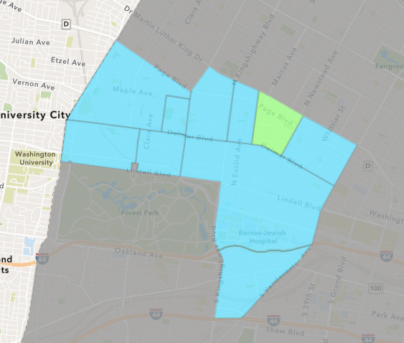
Lewis Place
Quarter 2 , 2020 Neighborhood Cost Breakdown
Sum of Permits: $700
Mean: $233
Median: $100
Range: $100 - $500

Slide 61
Lewis Place: Summary Notes
3 building permits in Quarter 2, 2020
200.00% change compared to Quarter 2, 2019 (1 total building permits)
$233: Average building permit cost in Quarter 2, 2020
-98.44% change compared to Quarter 2, 2019 ($15,000)

Slide 62
Lewis Place: Summary Notes
1 residential permits in Quarter 2, 2020
Infinite change compared to Quarter 2, 2019 (0 total building permits)
$500: Average residential building permit cost in Quarter 2, 2020
Infinite change compared to Quarter 2, 2019 ($0)
0 industrial permits in Quarter 2, 2020
0.00% change compared to Quarter 2, 2019 (0 total building permits)
$0: Average industrial building permit cost in Quarter 2, 2020
0.00% change compared to Quarter 2, 2019 ($0)

Slide 63
Lewis Place: Summary Notes
2 commercial permits in Quarter 2, 2020
100.00% change compared to Quarter 2, 2019 (1 total building permits)
$100: Average commercial building permit cost in Quarter 2, 2020
-99.33% change compared to Quarter 2, 2019 ($15,000)
0 residential permits in Quarter 2, 2020
0.00% change compared to Quarter 2, 2019 (0 total building permits)
$0: Average institutional building permit cost in Quarter 2, 2020
0.00% change compared to Quarter 2, 2019 ($0)

Slide 64
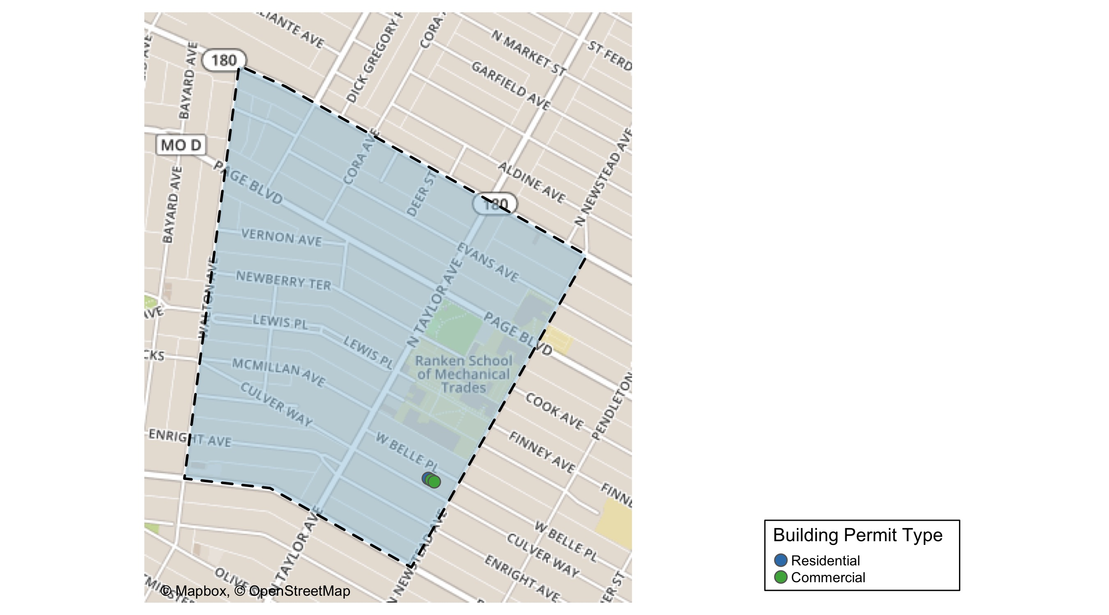
Lewis Place

Slide 65
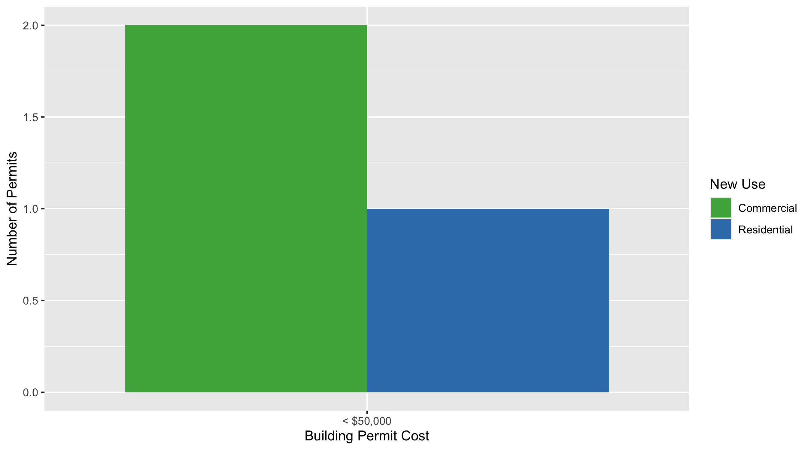
Lewis Place Permit Use Breakdown

Slide 66
Lewis Place Permit Breakdown
Quarter 2, 2020 | Quarter 2, 2020 | Quarter 2, 2020 | Quarter 2, 2020
Permit Use | Average Cost | # of Permits | Total Value of Permits
Commercial | $100 | 2 | $200
Industrial | $0 | 0 | $0
Institutional | $0 | 0 | $0
Residential | $500 | 1 | $500
Total | $600 | 3 | $700
Quarter 2, 2019 | Quarter 2, 2019 | Quarter 2, 2019 | Quarter 2, 2019
Permit Use | Average Cost | # of Permits | Total Value of Permits
Commercial | $15,000 | 1 | $15,000
Industrial | $0 | 0 | $0
Institutional | $0 | 0 | $0
Residential | $0 | 0 | $0
Total | $15,000 | 1 | $15,000

Slide 67
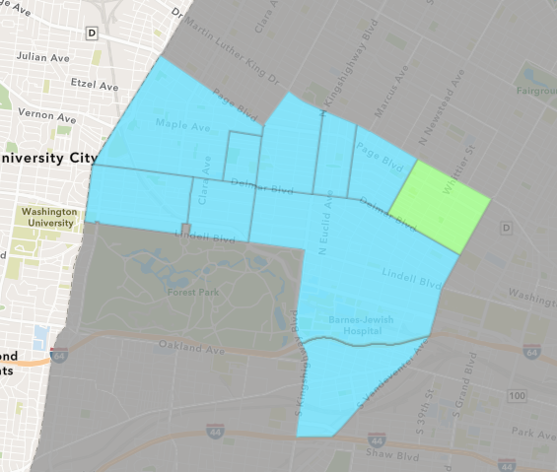
Vandeventer
Quarter 2 , 2020 Neighborhood Cost Breakdown
Sum of Permits: $147,700
Mean: $36,925
Median: $11,100
Range: $500 - $125,000

Slide 68
Vandeventer: Summary Notes
4 building permits in Quarter 2, 2020
-63.64% change compared to Quarter 2, 2019 (11 total building permits)
$36,925: Average building permit cost in Quarter 2, 2020
93.86% change compared to Quarter 2, 2019 ($19,047)

Slide 69
Vandeventer: Summary Notes
3 residential permits in Quarter 2, 2020
-72.73% change compared to Quarter 2, 2019 (11 total building permits)
$49,067: Average residential building permit cost in Quarter 2, 2020
157.60% change compared to Quarter 2, 2019 ($19,047)
0 industrial permits in Quarter 2, 2020
0.00% change compared to Quarter 2, 2019 (0 total building permits)
$0: Average industrial building permit cost in Quarter 2, 2020
0.00% change compared to Quarter 2, 2019 ($0)

Slide 70
Vandeventer: Summary Notes
0 commercial permits in Quarter 2, 2020
0.00% change compared to Quarter 2, 2019 (0 total building permits)
$0: Average commercial building permit cost in Quarter 2, 2020
0.00% change compared to Quarter 2, 2019 ($0)
1 residential permits in Quarter 2, 2020
Infinite change compared to Quarter 2, 2019 (0 total building permits)
$500: Average institutional building permit cost in Quarter 2, 2020
Infinite change compared to Quarter 2, 2019 ($0)

Slide 71
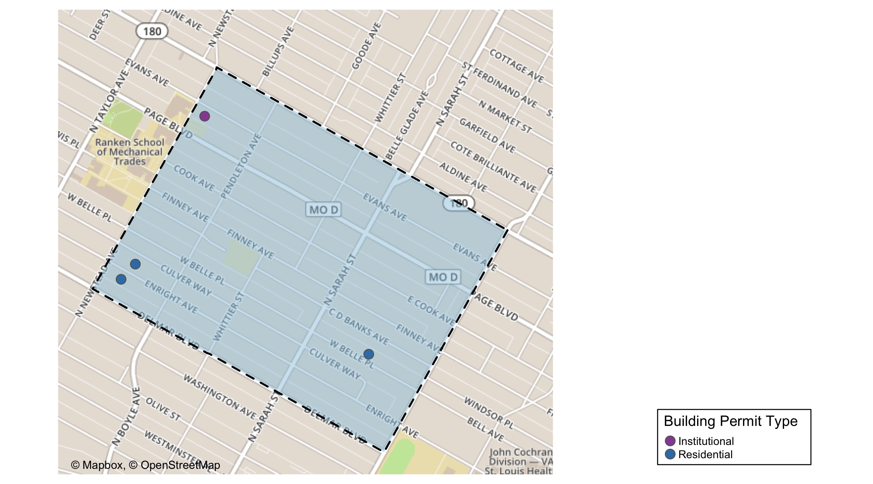
Vandeventer

Slide 72
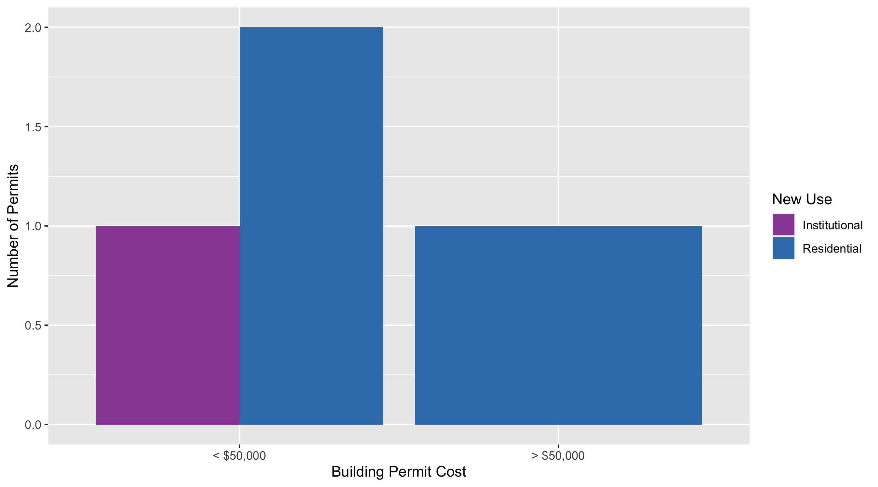
Vandeventer Permit Use Breakdown

Slide 73
Vandeventer Permit Breakdown
Quarter 2, 2020 | Quarter 2, 2020 | Quarter 2, 2020 | Quarter 2, 2020
Permit Use | Average Cost | # of Permits | Total Value of Permits
Commercial | $0 | 0 | $0
Industrial | $0 | 0 | $0
Institutional | $500 | 1 | $500
Residential | $49,067 | 3 | $147,200
Total | $49,567 | 4 | $147,700
Quarter 2, 2019 | Quarter 2, 2019 | Quarter 2, 2019 | Quarter 2, 2019
Permit Use | Average Cost | # of Permits | Total Value of Permits
Commercial | $0 | 0 | $0
Industrial | $0 | 0 | $0
Institutional | $0 | 0 | $0
Residential | $19,047 | 11 | $209,522
Total | $19,047 | 11 | $209,522

Slide 74
Additional Notes
Data retreived from https://www.stlouis-mo.gov/data/
Building permits with a cost of $0 were dropped
Building permits that were cancelled were dropped
Infinite change indicates 0 permits in the current or previous time period/comparison month so there was a overall increase or decrease

